Slide 1
Theory of Virtualization
BY
Naveen Kumar

Slide 2
Syllabus and Reference Books
THEORY OF VIRTUALIZATION (CS-1844) UNIT 1: Introduction, Overview of virtualization 8(L) UNIT 2: Hardware/Server virtualization 8(L) UNIT 3: Network virtualization 8(L) UNIT 4: Virtual machines 6(L)
Text/Reference Books:
Virtual Machines: Versatile Platforms for Systems and Processes by James E. Smith, Ravi Nair, Virtualization: From the Desktop to the Enterprise by Chris Wolf, Erick M. Halter Network virtualization by Kumar Reddy, Victor Moreno, Advanced Server Virtualization: VMware and Microsoft Platform in the Virtual Data Center by David Marshall, Wade A. Reynolds

Slide 3
Why Virtualization?
The key to managing the complexity in the computer system is their division into levels of abstraction separated by well defined interfaces.
Well defined interfaces allow computer design tasks to be decoupled so that teams of hardware and software designers can work independently.
AMD develops microprocessors that implement the Intel IA-32 instruction set, while software engineers at Microsoft develop compliers that map high level languages to the same instruction set.
Subsystems and components designed to the specifications for one interface will not work with those designed for another– This is the major drawback of well defined interfaces.

Slide 4
What is Virtualization and Virtual Machine?
Virtualization provides a way of relaxing the foregoing constraints and increasing flexibility.
When a system (or subsystem), e.g., a processor, memory, or I/O device, is virtualized, its interface and all resources visible through the interface are mapped onto the interface and resources of a real system actually implementing it.
Virtualization differs from abstraction as the virtualization does not necessarily hide details; the level of detail in a virtual system is often the same as that in the underlying real system.
A virtual machine (VM) is implemented by adding a layer of software to a real machine to support the desired virtual machine's architecture.
For example, virtualizing software installed on an Apple Macintosh can provide a Windows/IA-32 virtual machine capable of running PC application programs.

Slide 5
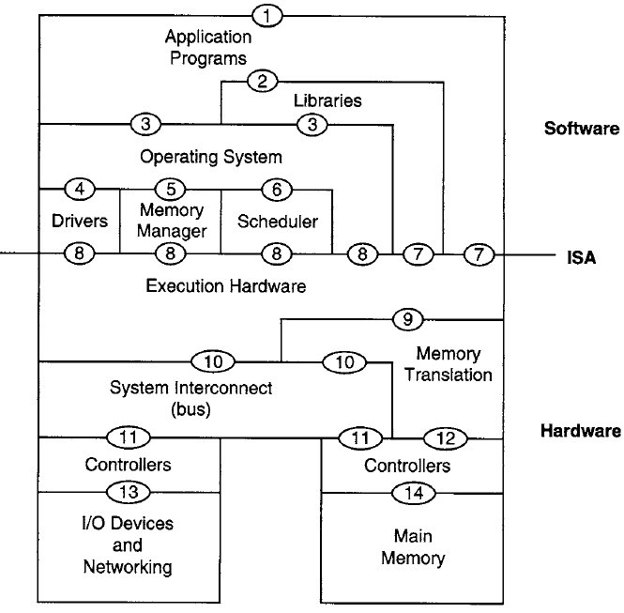
Computer System Architecture
Instruction Set Architecture (ISA): (7) user ISA & (8) user ISA and the system ISA.
Application Binary Interface (ABI): (3) & (7)
System Call: (3)
Application Programing Interface (API): (2) & (7)
Figure-1

Slide 6
ABI vs API
ABI is an interface between two binary program modules.
Often, one of these modules is a library or operating system facility, and the other is a program that is being run by a user.
An ABI defines how data structures or computational routines are accessed in machine code, which is a low-level, hardware-dependent format.
In contrast, an API defines this access in source code, which is a relatively high-level, hardware-independent, often human-readable format.
Adhering to an ABI is usually the job of a compiler, operating system, or library author; however, an application programmer may have to deal with an ABI directly when writing a program in a mix of programming languages.

Slide 7
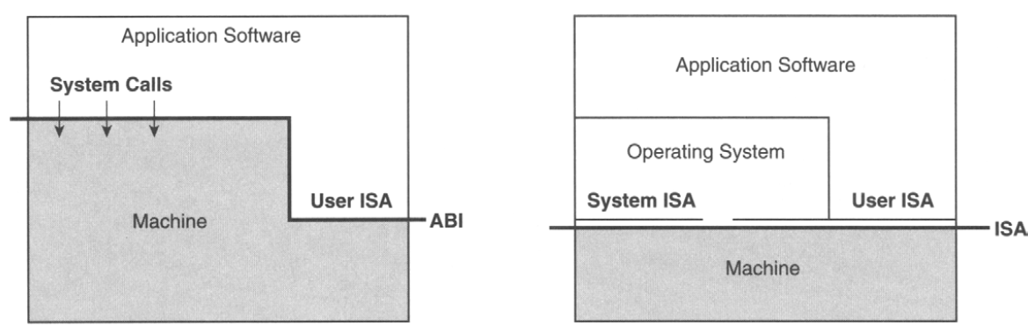
Machine Interfaces
(a)
(b)
Machine Interfaces. (a) Application binary interface (ABI); (b) instruction set architecture (ISA) interface.
Figure-2

Slide 8
The process of virtualization consists of two parts:
The mapping of virtual resources or state,
e.g., registers, memory, or files, to real resources in the underlying machine
The use of real machine instructions and/or system calls to carry out the actions specified by virtual machine instructions and/or system calls,
e.g., emulation of the virtual machine ABI or ISA.

Slide 9
Types of Virtual Machine
Process Virtual Machine (over ABI)
System Virtual Machine (over ISA)

Slide 10
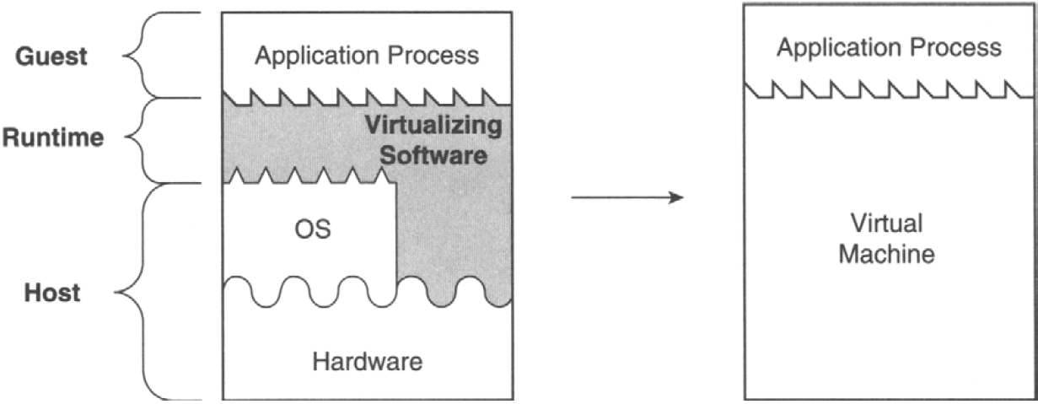
Process VM
A process virtual machine is capable of supporting an individual process.
In process VMs, the virtualizing software is placed at the ABI interface, on top of the OS/hardware combination.
The virtualizing software emulates both user-level instructions and operating system calls.
Figure-3

Slide 11
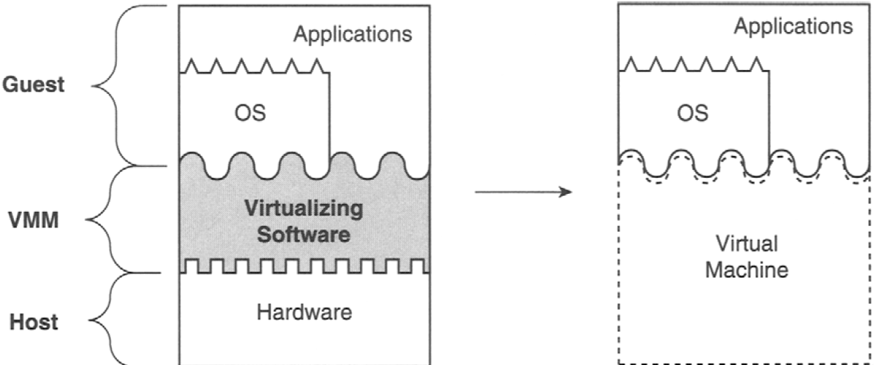
System Virtual Machine
A system virtual machine provides a complete system environment.
This environment can support an operating system along with its potentially many user processes.
It provides a guest operating system with access to underlying hardware resources, including networking, I/O, and, on the desktop, a display and graphical user interface.
Figure-4

Slide 12
The process VMs can provide replication, emulation, and optimization. Various implementation of system VM are:
Multiprogramming
Emulators and Dynamic Binary Translators
Same-ISA Binary Optimizers
High-Level Language Virtual Machines: Platform Independence

Slide 13
Process VM: Multiprogramming
The first and most common virtual machine is the combination of the OS call interface and the user instruction set forms the machine that executes a user process.
Most operating systems can simultaneously support multiple user processes through multiprogramming, where each user process is given the illusion of having a complete machine to itself.
Each process is given its own address space and is given access to a file structure.
The operating system timeshares the hardware and manages underlying resources to make this possible.
In effect, the operating system provides a replicated process-level virtual machine for each of the concurrently executing applications.

Slide 14
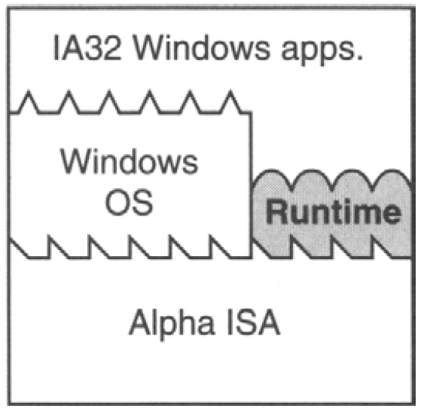
Process VM: Emulators and Dynamic Binary Translators
A more challenging problem for process-level virtual machines is to support program binaries compiled to a different instruction set than the one executed by the host's hardware, i.e., to emulate one instruction set on hardware designed for another.
FX!32 is a software emulator program that allows Win32 programs built for the Intel x86 instruction set to execute on DEC Alpha-based systems running Windows NT.
Two ways
Interpretation.
Binary translation
Figure-5

Slide 15
Interpretation
An interpreter program executing the target ISA fetches, decodes, and emulates the execution of individual source instructions.
This can be a relatively slow process, requiring tens of native target instructions for each source instruction interpreted.
Binary Translation
For better performance, binary translation is typically used.
With binary translation, blocks of source instructions are converted to target instructions that perform equivalent functions.
There can be a relatively high overhead associated with the translation process, but once a block of instructions is translated, the translated instructions can be cached and repeatedly executed much faster than they can be interpreted.
Because binary translation is the most important feature of this type of process virtual machine, they are sometimes called dynamic binary translators.

Slide 16
Process VM: Same-ISA Binary Optimizers
Same-lSA dynamic binary optimizers are implemented in a manner very similar to emulating virtual machines, including staged optimization and software caching of optimized code.
Same-ISA dynamic binary optimizers are most effective for source binaries that are relatively optimized to begin with, a situation that is fairly common in practice.
A dynamic binary optimizer can collect a profile and then use this profile information to optimize the binary code on the fly.
An example of such a same-ISA dynamic binary optimizer is the Dynamo system, originally developed as a research project at Hewlett-Packard [1].

Slide 17
Process VM: High-Level Language Virtual Machines (Cont’d)
VMs described earlier, allows cross-platform compatibility only on a case-by-case basis and requires a great deal of programming effort.
For example, if one wanted to run IA-32 binaries on a number of hardware platforms currently in use, e.g., SPARC, PowerPC, and MIPS, then an FX!32-1ike VM would have to be developed for each of them.
Full cross-platform portability is more easily achieved by taking a step back and designing it into an overall software framework.
One way of accomplishing this is to design a process-level VM at the same time as an application development environment is being defined.
Here, the VM is designed for ease of portability and to match the features of a high-level language (HLL) used for application program development.
These VMs are focused on minimizing hardware-specific and OS-specific features because these would compromise platform independence.

Slide 18
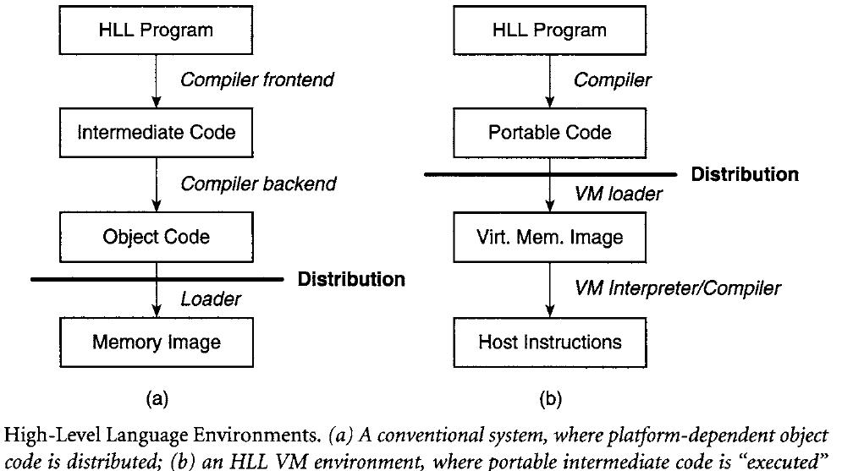
Process VM: High-Level Language Virtual Machines
The Sun Microsystems Java VM architecture and the Microsoft common language infrastructure (CLI), which is the foundation of the .NET framework, are more recent, widely used examples of HLL VMs.
The ISAs in both systems are based on bytecodes; that is, instructions are encoded as a sequence of bytes, where each byte is an opcode, a single-byte operand, or part of a multibyte operand.
These bytecode instruction sets are stack based (to eliminate register requirements) and have an abstract data specification and memory model.
In fact, the memory size is conceptually unbounded, with garbage collection as an assumed part of the implementation.
Because all hardware platforms are potential targets for executing Java- or CLI-based programs, applications are not compiled for a specific OS.
Rather, a set of standard libraries is provided as part of the overall execution environment.
Figure-6

Slide 19
System Virtual Machine (Cont’d)
System VM provide an environment in which many processes belonging to multiple users can coexist.
They were first developed in 1960s and early 1970s.
At that time the computers were very expensive so there is a need to share them between multiple users.
Different groups of users sometimes wanted different operating systems, the system VMs allows them to do so.
Over time, as hardware became much less expensive and much of it migrated to the desktop, interest in these classic system VMs faded.

Slide 20
System Virtual Machine
Today, system VMs becomes popular again.
The large, expensive mainframe systems are now servers or server farms, and these servers may be shared by a number of users or user groups.
Perhaps the most important feature of today's system VMs is that they provide a secure way of partitioning major software systems that run concurrently on the same hardware platform.
Software running on one guest system is isolated from software running on other guest systems.
The ability to support different operating systems simultaneously, e.g., Windows and Linux is another reason for their appeal, although it is probably of secondary importance to most users.

Slide 21
Various implementation of system VM are:
Classic System VMs
Hosted VMs
Whole System VMs
Codesigned VMs

Slide 22
System VM: Classic System VMs (Cont’d)
The classic approach to system VM architecture is given by Popek and Goldberg [2] in 1974 is shown in Figure.
The VMM is first placed on bare hardware, and virtual machines fit on top.
The VMM runs in the most highly privileged mode, while all the guests systems run with lesser privileges.
This system VM architecture is the most efficient, and it provides service to all the guest systems in a more or less equivalent way.
One disadvantage of this type of system, at least for desktop users, is that installation requires wiping an existing system clean and starting from scratch, first installing the VMM and then installing guest operating systems on top.
Another disadvantage is that I/O device drivers must be available for installation in the VMM, because it is the VMM that interacts directly with I/O devices.

Slide 23
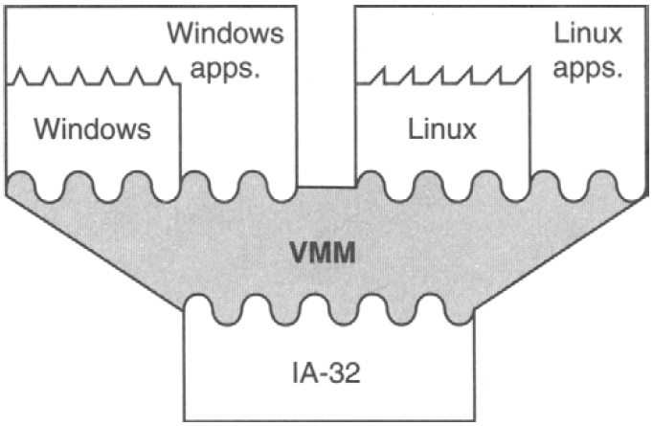
System VM: Classic System VMs
Figure-7

Slide 24
System VM: Hosted VMs
An alternative system VMM implementation builds virtualizing software on top of an existing host operating system ~ resulting in what is called a hosted VM.
With a hosted VM, the installation process is similar to installing a typical application program. Furthermore, virtualizing software can rely on the host OS to provide device drivers and other lower-level services; they don't have to be provided by the VMM.
The disadvantage of this approach is that there can be some loss of efficiency because more layers of software become involved when OS service is required.
The hosted VM approach is taken in the VMware implementation (VMware 2000), a modern system VM that runs on IA-32 hardware platforms.

Slide 25
System VM: Whole System VMs (Emulation) (Cont’d)
In the conventional system VMs described earlier, all the system software (both guest and host) and application software use the same ISA as the underlying hardware.
In some important situations, however, the host and guest systems do not have a common ISA.
For example, the Apple PowerPC-based systems and Windows PCs use different ISAs (and different operating systems), and they are the two most popular desktop systems today.
Because software systems are so closely tied to hardware systems, this may require purchase of multiple platform types, even when unnecessary for any other reason, which complicates software support and/or restricts the availability of useful software packages to users.

Slide 26
System VM: Whole System VMs (Cont’d)
This situation motivates system VMs, where a complete software system, both OS and applications, is supported on a host system that runs a different ISA and OS.
These are called whole-system VMs because they essentially virtualize all software.
Because the ISAs are different, both application and OS code require emulation, e.g., via binary translation.
For whole-system VMs, the most common implementation method is to place the VMM and guest software on top of a conventional host OS running on the hardware.

Slide 27
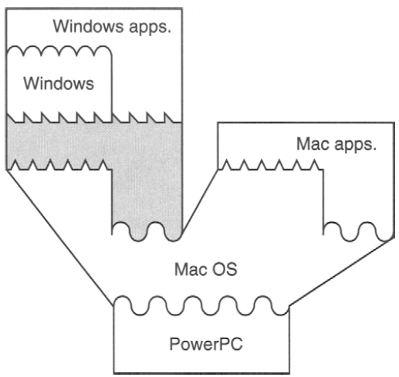
System VM: Whole System VMs
Figure 8 illustrates a whole-system VM built on top of a conventional system with its own OS and application programs.
An example of this type of VM is Virtual PC [3], which enables a Windows system to run on a Macintosh platform.
The VM software executes as an application program supported by the host OS and uses no system ISA operations.
It is as if the VM software, the guest OS, and guest application(s) are one very large application implemented on the host OS and hardware.
Meanwhile the host OS can also continue to run applications compiled for the native ISA; this feature is illustrated in the right-hand section of the drawing.
Figure-8

Slide 28
System VM: Codesigned VMs (Hardware Optimization)
In all the VM models the goal has been functionality and portability either to support multiple (possibly different) operating systems on the same host platform or to support different ISAs and operating systems on the same platform.
In practice, these virtual machines are implemented on hardware already developed for some standard ISA and for which native (host) applications, libraries, and operating systems already exist.
Yet now, improved performance (i.e., going beyond native platform performance) has not been a goal- in fact minimizing performance losses is often the performance goal.
Codesigned VMs are designed to enable innovative ISAs and/or hardware implementations for improved performance, power efficiency, or both.

Slide 29
System VM: Codesigned VMs (Cont’d)
The host's ISA may be completely new, or it may be based on an existing ISA with some new instructions added and/or some instructions deleted.
In a codesigned VM, there are no native ISA applications.
It is as if the VM software is, in fact, part of the hardware implementation.
Because the goal is to provide a VM platform that looks exactly like a native hardware platform, the software portion of a codesigned VM uses a region of memory that is not visible to any application or system software.
This concealed memory is carved out of real memory at boot time and the conventional guest software is never informed of its existence.
VMM code that resides in the c practically any time and perform a number of different functions.

Slide 30
System VM: Codesigned VMs
In its more general form, the VM software includes a binary translator that converts guest instructions into native ISA instructions and caches the translated instructions in a region of concealed memory.
Hence, the guest ISA never directly executes on the hardware. Of course, interpretation can also be used to supplement binary translation, depending on performance tradeoffs.
To provide improved performance, translation is coupled with code optimization.
Optimization of frequently executed code sequences is performed at translation time, and/or it is performed as an ongoing process while the program runs.
Perhaps the best-known example of a codesigned VM is the Transmeta Crusoe [4].

Slide 31
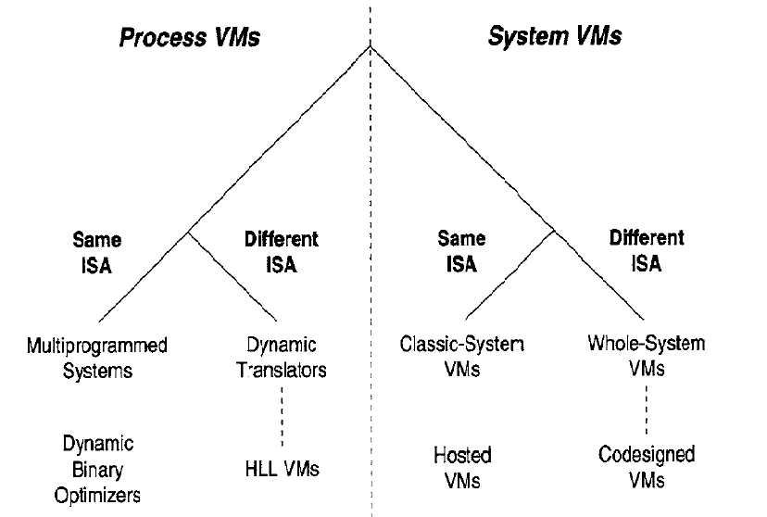
VM Taxonomy
Figure-9

Slide 32
References
[1] Bala, V., E. Duesterwald, and S. Banerjia. 2000. Dynamo" A Transparent Dynamic Optimization System, Proc. A CM SIGPLAN Conf. Programming Language Design and Implementation (June), pp. 1-12.
[2] Popek, G. J. and R. P. Goldberg. 1974. Formal Requirements for Virtualizable Third-Generation Architectures, Communications of the A CM (July), pp. 412-421.
[3] Traut, E. 1997. Building the Virtual PC, Byte (November), pp. 51-52.
[4] Halfhill, T. R. 2000. Transmeta Breaks x86 Low-Power Barrier, Microprocessor Report (February 14), pp. 9-18.

Slide 33
Some Links
x86 Architecture
https://en.wikipedia.org/wiki/X86_instruction_listings
List of System Calls
http://asm.sourceforge.net/syscall.html
Building your own Hypervisor
https://rayanfam.com/topics/hypervisor-from-scratch-part-1/

